Slide 1





C# Database Fundamentals with Microsoft SQL Server
Course Overview
C# DB
Basics
SoftUni Team
Technical Trainers
Software University
http://softuni.bg

Slide 2



Table of Contents
Course Objectives
Course Program
Trainers Team
Course Schedule
Exams and Evaluation
Learning Resources

Slide 3

DB Fundamentals Module @ SoftUni
Database Fundamentals
Intensive 4 Months Databases Training

Slide 4
DB Fundamentals Module Goals
4 months intensive database development training
4 times weekly, lots of live coding, homework and projects
Part I – DB Basics
SQL Server Concepts, SQL & T-SQL, table relationships …
Part II – DB Advanced
ADO.NET, Building an ORM Framework, Entity Framework Core, advanced queries, architecture, working with JSON and XML

Slide 5
DB Fundamentals Module – Timeline
21-May-2018
24-Jun-2018
12-Aug-2018
Database
Basics
Lessons + exercises + exam
5 weeks * 4 times / week
9 credits
Start: 21-May-2018
Final exam: 24-Jun-2018
Database Advanced
Lessons + exercises + teamwork + exam
7 weeks * 4 times / week
18 credits
Start: 25-Jun-2018
Final exam: 12-Aug-2018
Re-Take Exams
2 Exams
Date pending

Slide 6


Database Basics
Basics
Course Objectives & Program

Slide 7

Course Objectives
The Database Basics course provides
Basic database and query concepts
Establishes fundamentals for further DB trainings
Content: SQL syntax, data types, programmability
What is NOT covered?
Client-side implementations
API Libraries

Slide 8

Course Topics
DB intro, data definition and data types
Basic CRUD, intro to SQL
Built-in functions with T-SQL
Data aggregation
Table relationships
Subqueries and joins
Database Programmability

Slide 9
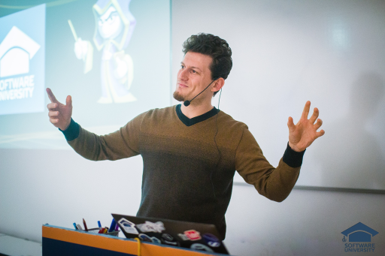
The Trainers Team

Slide 10
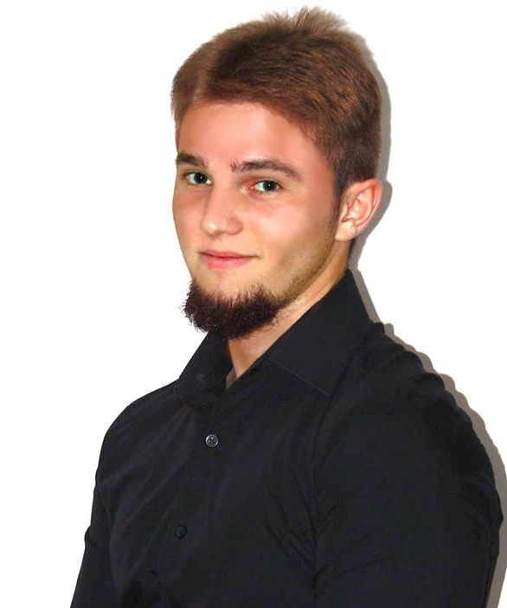
Trainers Team
Boris Kostov
Technical Trainer @ SoftUni
Student @ Sofia University
Information Systems
Interests in C#
Personal Trainer

Slide 11
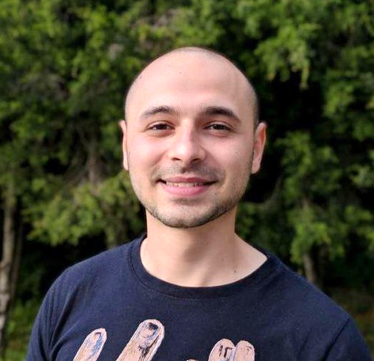
Trainers Team
Stoyan Shopov
Technical Trainer @ SoftUni
ASP.NET Web Developer
Experience with MSSQL, ADO.NET
Interested in self-development and business
Mountain lover

Slide 12
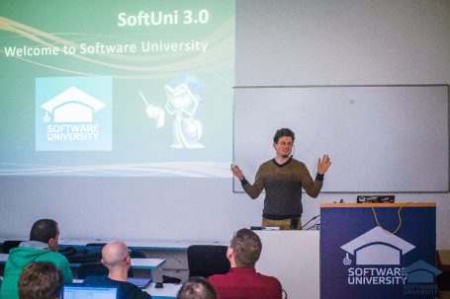


Database Basics
Course Details and Schedule

Slide 13
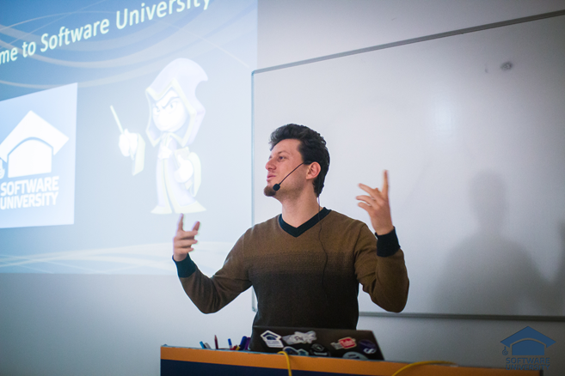
Training Duration and Schedule
Lessons: ~ 20 hours (onsite + YouTube videos)
Practical exercises (in class): ~ 40 hours
Homework: ~ 0-50 hours
Time frame
21-May-2018 – 12-Aug-2018

Slide 14


Why English?
Why the slides are in English?
English is the native language of the software engineers
Specific terminology should be in English
Translations are inaccurate and funny
Just learn English!
No excuses

Slide 15


Your RFID Chip
Students can either
Take RFID chip from SoftUni
Or use their own chip / card (125 KHz)
Register your chip number in your SoftUni profile: https://softuni.bg/users/profile/show
Check-in at the reception every time when you come in SoftUni
See your last visits in your profile: https://softuni.bg/users/profile/show

Slide 16

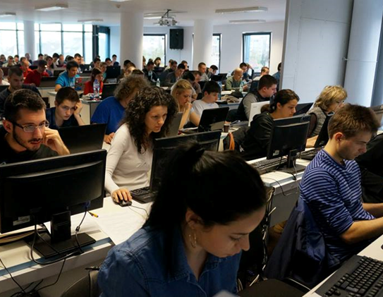
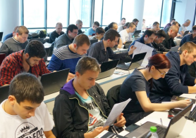
Database Basics
Evaluation Criteria

Slide 17
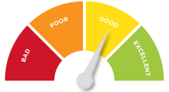

Scoring System for the Course
Mandatory:
Final exam – 85%
Exercises & homework – 15%
Bonuses:
Presence in class – 5% bonus
Forum activity – bonus up to 5%

Slide 18


Homework Assignments & Exercises
Your homework is mainly work in class!
Lesson days → slides + live demos + exercises
Exercise days → only exercises
How to submit your homework?
Submitted in the judge system
Do your homework when it's due!
Assignments pile up quickly

Slide 19










Resources
What We Need Additionally?

Slide 20



Course Web Site, Forum and FB Group
Official web site:
Official discussion forum:
Official Facebook group:
https://softuni.bg/courses/databases-sqlsrv
softuni.bg/forum/categories/63
facebook.com/groups/ SoftUniCsharpDBFundamentalsMay2018/

Slide 21

The DB Fundamentals Slides and Videos
All lecture slides, videos, homework assignments, projects and other resources are open content, available for free
Visit the course web site to access the course resources

Slide 22



Recommended Software
Software needed for this course:
Microsoft SQL Server & Management Studio https://www.microsoft.com/en-us/sql-server/sql-server-2017
Visual Studio 2017 – https://www.visualstudio.com

Slide 23







Course Introduction
https://softuni.bg/courses/databases-sqlsrv

Slide 24






SoftUni Diamond Partners

Slide 25






SoftUni Diamond Partners

Slide 26
License
This course (slides, examples, demos, videos, homework, etc.) is licensed under the "Creative Commons Attribution-NonCommercial-ShareAlike 4.0 International" license
Attribution: this work may contain portions from
"Databases" course by Telerik Academy under CC-BY-NC-SA license

Slide 27





Trainings @ Software University (SoftUni)
Software University – High-Quality Education, Profession and Job for Software Developers
softuni.bg
Software University Foundation
http://softuni.foundation/
Software University @ Facebook
facebook.com/SoftwareUniversity
Software University Forums
forum.softuni.bg

